Slide 1

Association Rule Mining For Collaborative Recommender System
Presented By Project Supervisor
Rahul Kumar Dr. Malaya Dutta Borah
Scholar Id- 19-22-110 Assistant Professor
Department of CSE NIT Silchar ,Assam Department of CSE NIT Silchar ,Assam

Slide 2
Contents
Introduction
Literature Survey
Problem Statement
Model Implementation
Flow Chart
Result
Future Work
Reference

Slide 3
Introduction
Association rule mining finds interesting associations and relationships among large sets of data items.
This rule shows how frequently a item set occurs in a transaction. A typical example is Market Based Analysis.
Market Based Analysis is one of the key techniques used by large relations to show associations between items. It allows retailers to identify relationships between the items that people buy together frequently.

Slide 4
Introduction(Cont…)
Before we start defining the rule, let us first see the basic definitions.
Support Count(∑) – Frequency of occurrence of a itemset.
Here ∑ ({Milk, Bread, Diaper})=2
Frequent Itemset – An itemset whose support is greater than or equal to minsup threshold.
Association Rule – An implication expression of the form X -> Y, where X and Y are any 2 itemsets. Example: {Milk, Diaper}->{Beer}

Slide 5
Need of Association Mining
Association Mining:- Association Mining searches for frequent items in the data-set. In frequent mining usually the interesting associations and correlations between item sets in transactional and relational databases are found. In short, Frequent Mining shows which items appear together in a transaction or relation.
Need of Association Mining:- Frequent mining is generation of association rules from a Transactional Dataset. If there are 2 items X and Y purchased frequently then its good to put them together in stores or provide some discount offer on one item on purchase of other item. This can really increase the sales. For example it is likely to find that if a customer buys Milk and bread he/she also buys Butter. So the association rule is [‘milk]^[‘bread’]=>[‘butter’]. So seller can suggest the customer to buy butter if he/she buys Milk and Bread.

Slide 6
Some Important Definition
Support : It is one of the measure of interestingness. This tells about usefulness and certainty of rules. 5% Support means total 5% of transactions in database follow the rule.
Support(A -> B) = Support count(A ∪ B)
Confidence: A confidence of 60% means that 60% of the customers who purchased a milk and bread also bought butter.
Confidence(A -> B) = Support count(A ∪ B) / Support count(A) .If a rule satisfies both minimum support and minimum confidence, it is a strong rule.
Support count(X) : Number of transactions in which X appears. If X is A union B then it is the number of transactions in which A and B both are present.
Maximal Itemset: An itemset is maximal frequent if none of its supersets are frequent.
Closed Itemset:An itemset is closed if none of its immediate supersets have same support count same as Itemset.
K- Itemset:Itemset which contains K items is a K-itemset. So it can be said that an itemset is frequent if the corresponding support count is greater than minimum support count.

Slide 7
Motivation
Many of the top companies use recommender system to provide recommendation.
With exponential growth of information online popularity and need of recommender system has increased substaintialy. With music stream plateform becoming popular, more and more people going online for listening to music.
With the help of music recommender system,the system can give recommendation to users by analysing user’s music listening history so that users can find new music without the hassle of spending time searching and listening to new music.

Slide 8
Why Recommendation System Needed?
To overcome long tail phenomenon the web has given rise to.
The user just see products that they like the best and not waste their time with products,
they don’t care about.
The amount of products have increased so a new problem arose as people had a hard time selecting the items they actually want to see.
Recommender system allows website to increase profit by recommending more products.

Slide 9
What is Recommeder System?
Recommender System is a system that seeks to predict or filter preferences according to the user’s choices. Recommender systems are utilized in a variety of areas including movies, music, news, books, research articles, search queries, social tags, and products in general.
Recommender systems produce a list of recommendations in any of the two ways –
Collaborative filtering:- Collaborative filtering approaches build a model from user’s past behavior (i.e. items purchased or searched by the user) as well as similar decisions made by other users. This model is then used to predict items (or ratings for items) that user may have an interest in.
Content-based filtering:- Content-based filtering approaches uses a series of discrete characteristics of an item in order to recommend additional items with similar properties. Content-based filtering methods are totally based on a description of the item and a profile of the user’s preferences. It recommends items based on user’s past preferences.

Slide 10
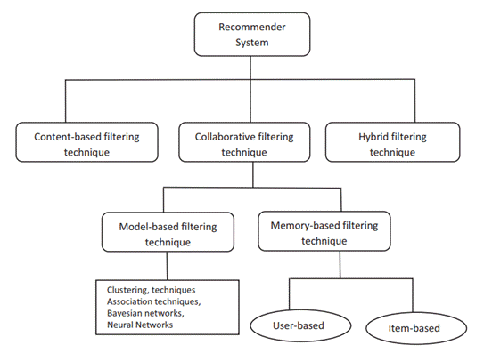
Types of Recommender System

Slide 11
Literature Survey
Sr. No | Author | Name of Paper | Journal/Conference | Findings
1 | M. A.Hameed, O. A.Jadaan, S. Ramachandram, | Collaborative Filtering Based Recommendation System: A survey | International Journal on Computer Science and Engineering, vol 4.5, May 2012 | Overview of various recommender system. Limitations of various of different types of recommender system
2 | S. Mann, M. Sharma | A Survey of Recommender Systems: Approaches and Limitations | International Journal of Innovations in Engineering and Technology, vol.2, pp. 8-14, 2013 | Limitations of content based and memory based collaborative filtering method.

Slide 12
Literature Survey(Cont…)
Sr. No | Author | Name of Paper | Journal/Conference | Findings
3 | P. H.Aditya, I. Budi, Q.Munajat | A comparative analysis of memory-based and model-based collaborative filtering on the implementation of recommender system for E-commerce in Indonesia: A case study PT X. | International Conference on Advanced Computer Science and Information Systems (ICACSIS), Malang, Indonesia, 2016 | Accuracy of model-based is 10 times better than memory-based.
4 | B. T. Betru,C. A. Onana,B.Batchakui | Deep Learning Methods on Recommender System: A Survey of State-of-the-art | International Journal of Computer Applications, Vol 162, No 10, March 2017. | Understanding various deep learning methods 1. Recurrent neural network 2. Convolutional neural network

Slide 13
Literature Survey(Cont…)
Sr. No | Author | Name of Paper | Journal/Conference | Findings
5 | S. Zhang, L. Yao, A. Sun, Y. Tay. | Deep Learning Based Recommender System: A Survey and New Perspectives | ACM Computing Surveys, Vol 52, Feb 2019 | Overview of various deep learning techniques
6 | R. Mu | A Survey of Recommender Systems Based on Deep Learning | IEEE Access, vol. 6, Nov 2018 | Survey on deep learning methods 1.Autoencoder 2. Restricted Boltzmann machine

Slide 14
Literature Survey(Cont…)
Sr. No | Author | Name of Paper | Journal/Conference | Findings
7 | Y. Hu, Y. Koren, C. Volinsky | Collaborative Filtering for Implicit Feedback Datasets | Eighth IEEE International Conference on Data Mining, Pisa, Italy, Dec 2008 | Details of how to use implcit feedback in deep learning
8 | G. Jawaheer, M. Szomszor, P. Kostkova | Comparison of implicit and explicit feedback from an online music recommendation Service | Proceedings of the 1st International Workshop on Information Heterogeneity and Fusion in Recommender Systems, 2010 | Comparing against results of collaborative Filtering engine by Apache using artist play count as implicit feedback

Slide 15
Problem Statement
To design a music recommender system using deep learning method called restricted boltzmann machine with user music play count as implicit feedback of individual user to provide recommendation.

Slide 16
Recommender System Comparison
Content based methods | Collaborative filtering methods | Hybrid methods
1. Prediction made based on user-item matrix . | 1. Prediction made using similarity of methods | 1. Prediction made combining content based and/or collaborative filtering methods.
2. Scalability: Not easier to scale | 2.Scalability: Easier to scale | 2.Scalability: Easier to scale
3. Overspeciliazation: It tends to recommend same types of Items | 3. Overspecialzation is not present as similarity measures are used | 3. Overspecilization depends on type of method used.
4. Slower reommendation | 4. Faster recommendation | 4. Slower compared to model based approach
5. Less prediction accuracy | 5. Higher prediction accuracy | 5. Higher prediction accuracy but increase in complexity

Slide 17
Comparison of Collaborative Filtering Methods
Memory based approach | Model based approach
1. Memory based approaches uses useritem matrix to make prediction | 1. Predictions are made by estimating parameters of statistical models
2. Sparsity: Accuracy decreases when user-item matrix is sparse | 2. Sparsity: Accuracy is greater than model based approach.
3. Prediction speed: Prediction is speed is slow as whole user-item matrix is used | 3. Prediction speed: Prediction is speed is more compared to memory based approach
4. Storagein : Storage requirement main memory is higher | 4. Storage: The model created using model based approach is much smaller than memory based approach.

Slide 18
Types of Model Based Methods
1. Clustering techniques - In cluster model, like minded users are clustered in to classes and
thus clustering is used to estimate the ratings by grouping the users into different classes
.
2. Bayesian network- Bayesian networks are a type of probabilistic graphical model that uses
Bayesian inference for probability computations.
3. Deep learning- Deep learning is used to extract high level features from the raw input.

Slide 19
Advantages of Deep learning methods over other model based approach
Non linear Transformation: Deep neural networks are capable of modelling the nonlinearity
in data. This property makes it possible to capture complex patterns .
Privacy: Model is trained offline and only the trained model is kept online .
Non numerical feedback: Dealing with images, audio, text would be a tough task without
the help of deep learning techniques.
Clustering techniques has limitation that user can only be placed in one cluster at a time
and today almost all applications require to cluster the user in several categories at a time

Slide 20
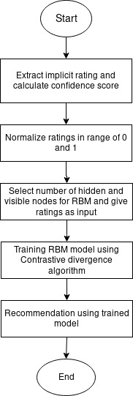
Flowchart of Music Recommender System using RBM

Slide 21
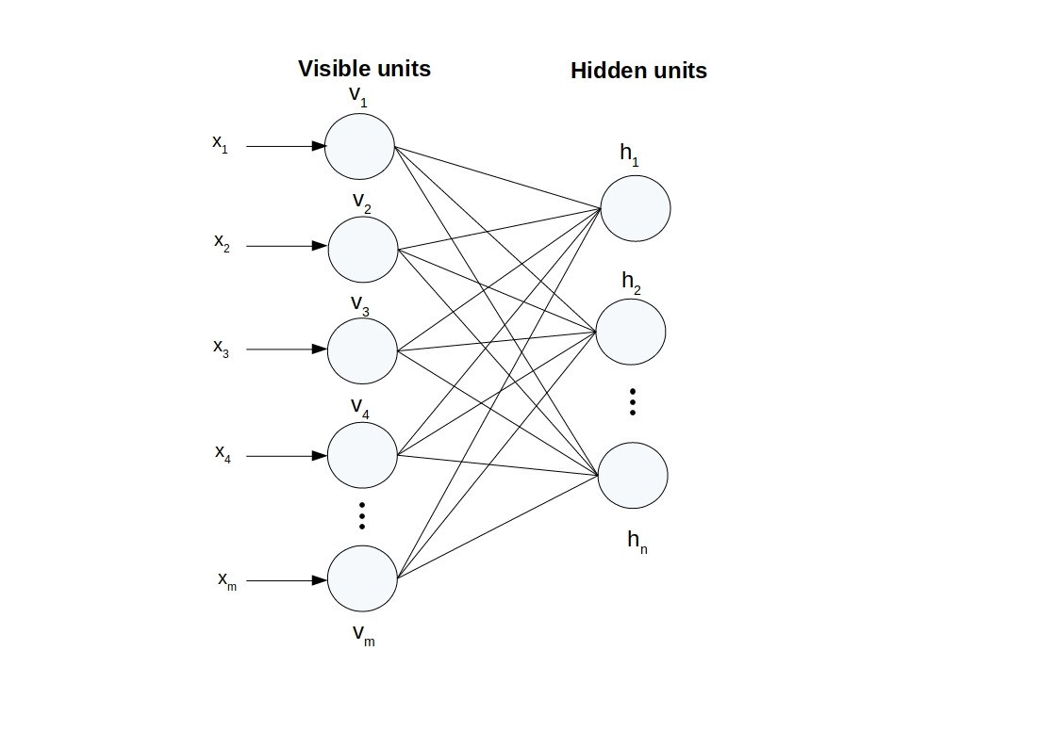
Restricted Boltzmann machine (RBM)

Slide 22
RBM(Cont…)
It is a generative stochastic artificial neural network.
Contains only one visible unit layer and one hidden unit layer.
No intra layer connections – No connections exist among visible nodes and hidden nodes.
Fully bipartite graph – Every node in visible layer is connected to every node in hidden layer and vice versa.
Nodes makes stochastic decision, to be turned on or off

Slide 23
RBM(Cont…)
Given m songs and n users, there will be m visible input nodes.
Hidden nodes are chosen by the implementer.
Number of times listened to music is used as implicit feedback.
Ratings of songs are input to the visible layer nodes.
Confidence score calculation
g = αp if p>0
g = 0 if p=0
where α is how confident a user is going to like the song and p is how many times user has listened to the music.
Confidence scores are normalized to the range of 0 to 1.

Slide 24
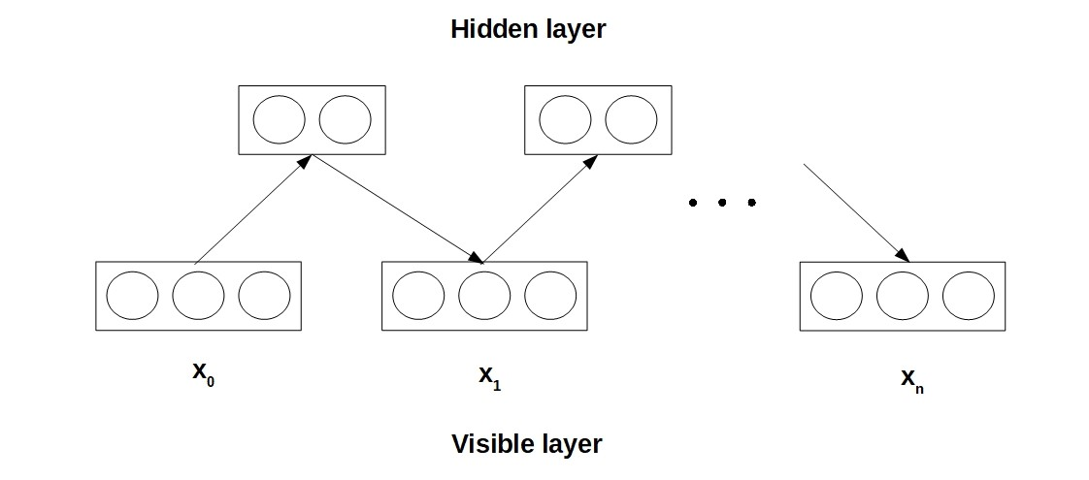
Contrastive Divergence algorithm

Slide 25
Contrastive Divergence algorithm(Cont…)
Start with a training vector on the visible units.
Update all the hidden units in parallel.
Update the all the visible units in parallel to get a “reconstruction”.
Update the hidden units again.
Update weights and biases

Slide 26
Contrastive Divergence algorithm (cont...)
Contrastive divergence algorithm is used for training RBM model.
Step 1: Take input vector to the visible node and select epochs.
Step 2: Update the weights and values of hidden nodes in parallel. All of the units in hidden layer are calculated in parallel given the current states of the units in the visible layer.
Step 3: Reconstruct the input vector with the same weights used for hidden nodes. Even though we use the same weights, the reconstructed input will be different as multiple hidden nodes contribute the reconstructed input.
Step 4: Update the value of weights and biases of visible and hidden layer nodes.
wj = wj + Δwj aj = aj + Δaj bj =bj+Δbj
Step 5: Repeat step 2, 3 and 4 for set number of epochs

Slide 27
Result
Eighty percent data used as training set and Twenty percent data used as testing set.
Error measurement for recommendation: Normalized Root Mean square error (NRMSE) is
used where the root mean square error values are normalized to range of 0 to 1.
Technique | Error (NRMSE)
Collaborative filtering engine by Apache | 0.0200
RBM | 0.0075

Slide 28
Future works
More types of implicit feedbacks can be included to improve recommendation accuracy of the algorithm.
This method can be tested by using other accuracy measures.
Method can be trained by changing parameters of weights, bias and learning rate.

Slide 29
References
[1]M. Sharma and S. Mann, “A Survey of Recommender Systems: Approaches and Limitations”. In International Journal of Innovations in Engineering and Technology, vol.2, pp. 8-14, 2013.
[2] M. A. Hameed, O. A. Jadaan, and S. Ramachandram, "Collaborative filtering based recommendation system: A survey". In International Journal on Computer Science and Engineering, vol 4.5, pp. 859-876, May 2012.
[3] S. Zhang, L. Yao, A. Sun and Y. Tay, “Deep Learning Based Recommender System: A Survey and New Perspectives”.In ACM Computing Surveys, Vol 52, pp. 1–38, Feb 2019.
[4] R. Mu, "A Survey of Recommender Systems Based on Deep Learning". In IEEE Access, vol. 6, pp. 69009-69022, Nov 2018.
[5] Y. Hu, Y. Koren and C. Volinsky, "Collaborative Filtering for Implicit Feedback Datasets". In Eighth IEEE International Conference on Data Mining, Pisa, Dec 2008, pp. 263-272.

Slide 30
Thank You

